Slide 1
Restaurant based recommendation System
Team Members:
Sowjanya Tammali
Faisal Irshad Dakhani
Naga Sai surya Prakash Reddy Kovvuri
Divya Pulivarthy

Slide 2
Abstract
A recommender system is an effective way to help users to obtain personalized and helpful information as users nowadays are trying out multiple cuisines based on web applications or mobile-based applications recommendations. But there are numerous factors affecting the choice of restaurant for a user, such as geolocation, reviews, type of cuisine available, etc. In this paper, we propose a recommendation system that helps users adopt a restaurant based on their interests. The factors considered for this model are reviews, overall ratings, service ratings, food ratings, type of cuisine available, and budget. For this recommendation system, we can consider two models; one is Collaborative Filtering, and the other is a Content-based recommendation system.
Here, our model primarily focuses on a Restaurant Recommendation system based on Collaborative filtering that effectively helps users find a restaurant of their choice.

Slide 3
Project Goal
The literature review done on three research papers focus mainly on developing a Restaurant Recommendation System using Machine Learning with restaurant features, including cuisines available, location, and user's preference of food.
Our Project's main aim is to include users personal qualities and habits, such as parking lot preferences, mode of payment and drinking level, etc., to recommend restaurants along with the above-mentioned features.

Slide 4
Data Collection
The data set is obtained from the UCI machine learning repository. Then, we will link shared qualities with the data from many datasets to create a single dataset. This data set has various columns defining the user characteristics and Restaurant features, allowing collaborative filtering-based restaurant recommendation systems to be more accurate and user-centered. Therefore, making these columns ideal for a data scientist to develop a model using the given columns with better accuracy.

Slide 5
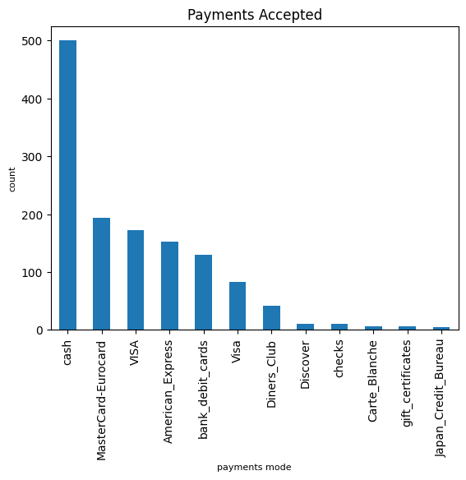
Most accepted payments by restaurants

Slide 6
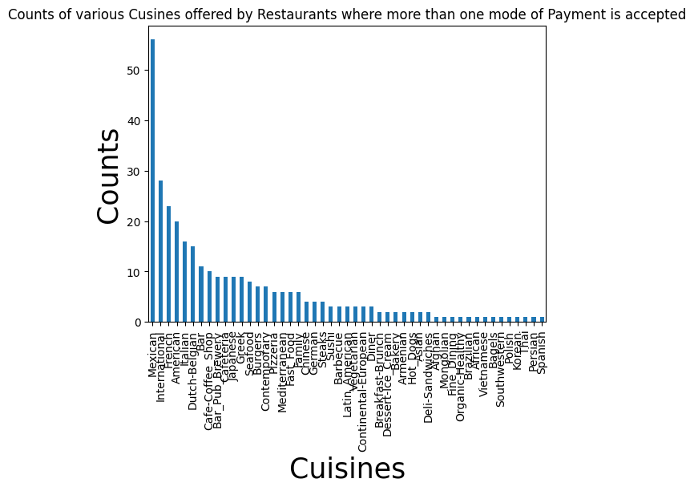
Visualization on payment modes and counts

Slide 7
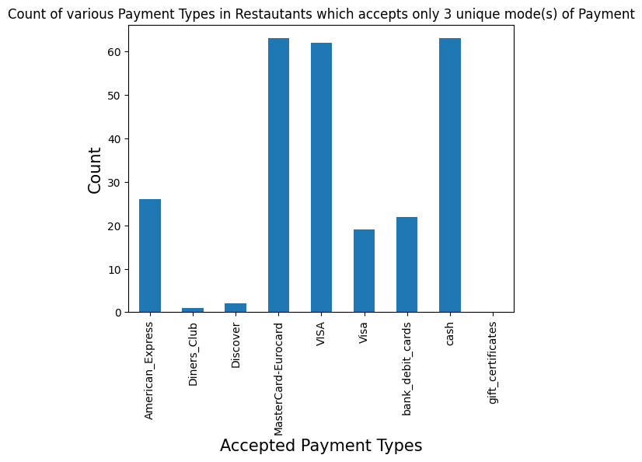
We see that those most of the stores who accepts only 3 mode of payment, accepts mostly visa, mastercards and less cash and lesser debit cards.
This may reveal a pattern that those stores which accept single mode of payments, does attract people with low budgets and those with more attracts people with high or medium budget.

Slide 8
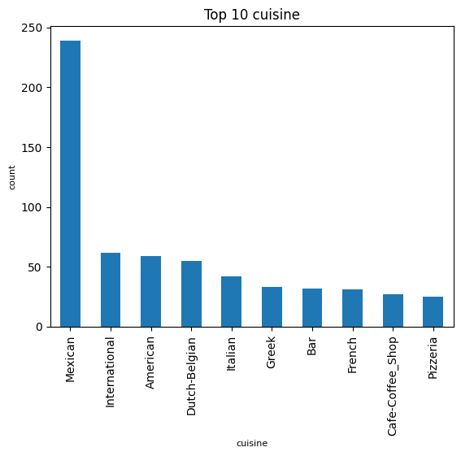
visualize top cuisines offered by the restaurants

Slide 9
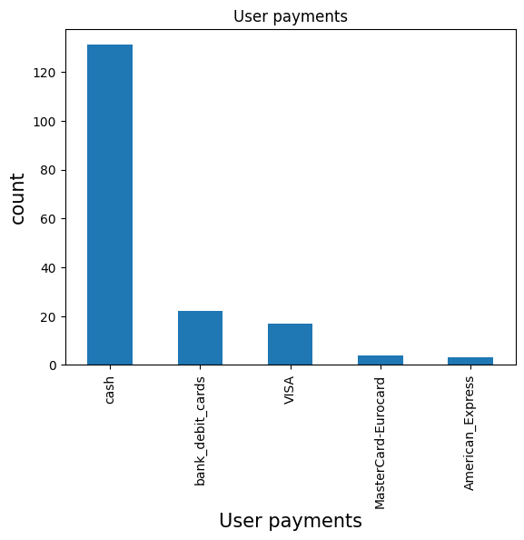
Top payments done by the users

Slide 10
Pre-processing techniques
If the data contains missing values, replacing it with Nan.
Finding out missing value percent in each variable and then replacing it with mode of that individual column.
Performed label encoding to convert characters to factors.
Replacing unknown values with Nan.
Dropped the columns which has more than 50% missing values and replacing remaining column values with mode.

Slide 11
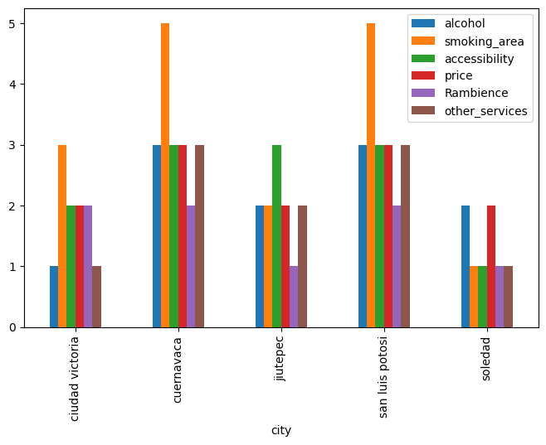
Visualization for facilities provided by restaurants based on city

Slide 12
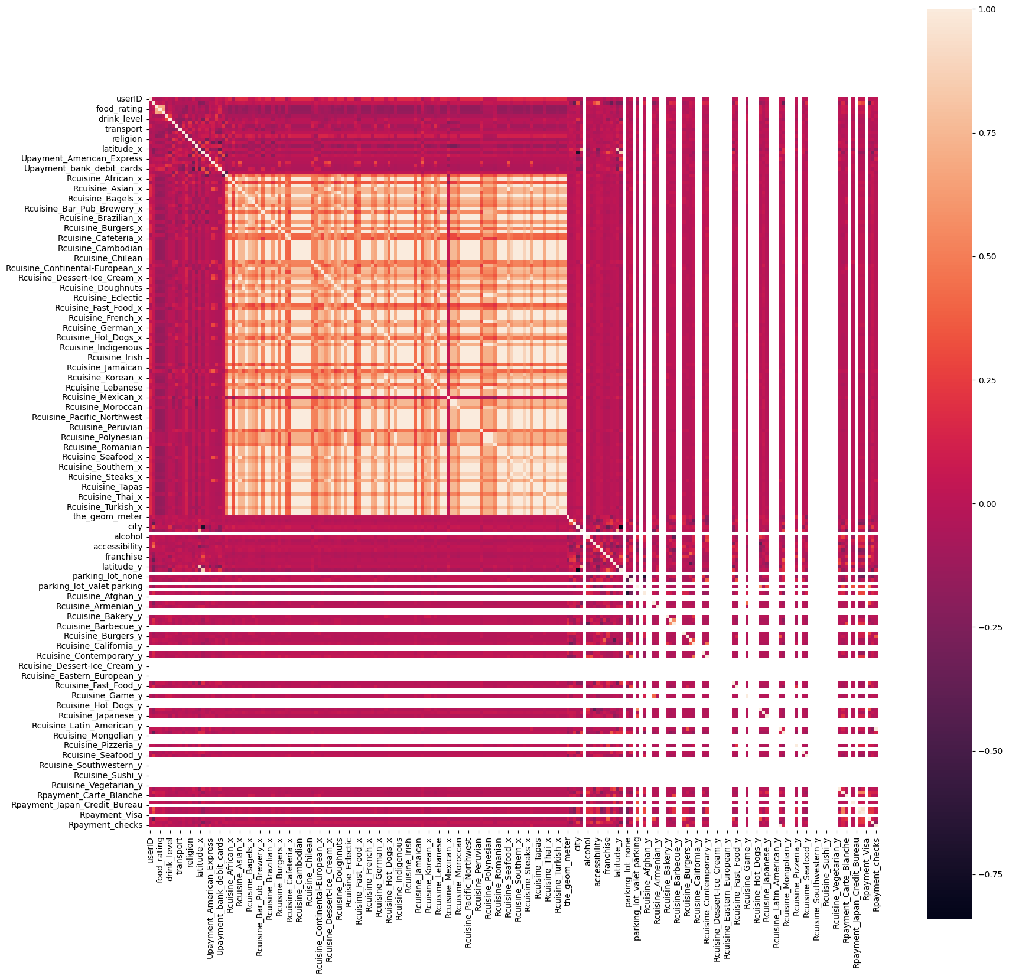
Exploratory Data Analysis
After cleaning, transforming and merging data, this is the heatmap of the final dataset.

Slide 13
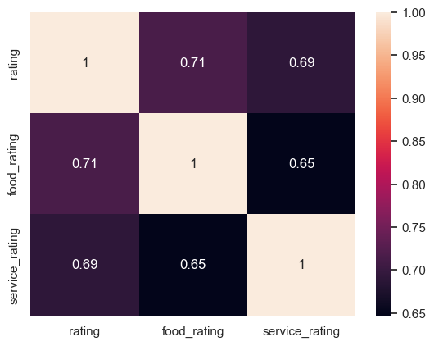
HeatMap of ratings provided by customers based on service, food and overall rating.

Slide 14
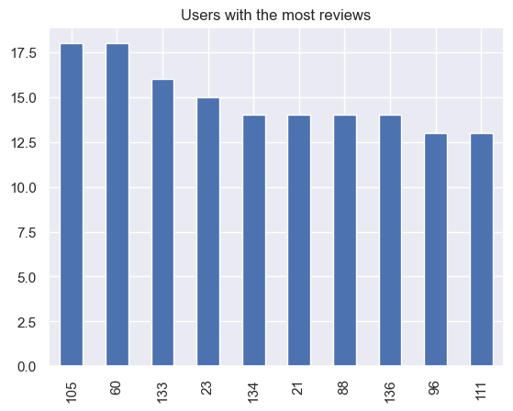
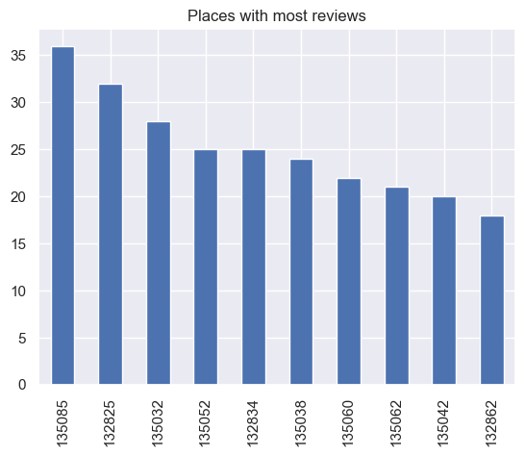
Determining users with most reviews Vs places with most reviews

Slide 15
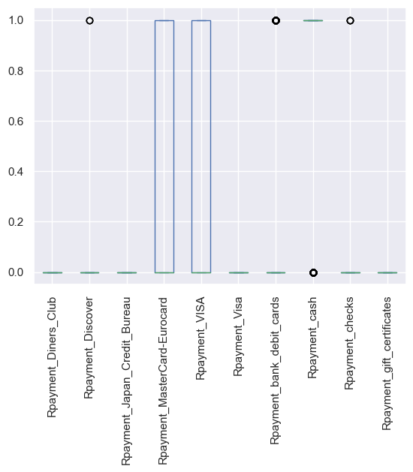
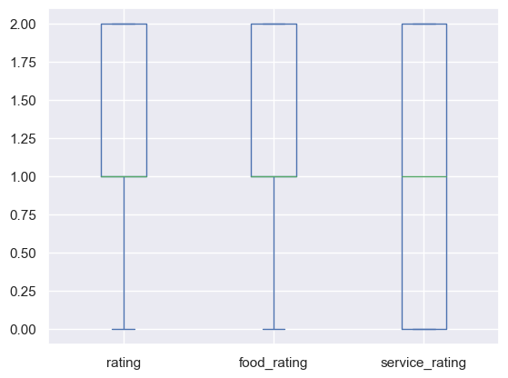
Box plot

Slide 16
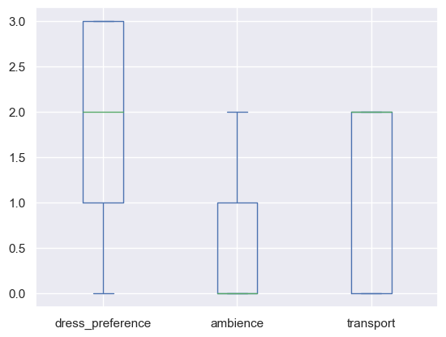
Box Plot for Preference, Ambience and Transport

Slide 17
Analysis after data cleaning and transformation
If a user doesn't have a car, they wouldn't care if there is parking, and the corresponding weight for 'parking_lot' is not needed.
If a user doesn't smoke, they wouldn't care if there is a smoking area, and a corresponding weight for 'smoking_area' is not needed.
Users with different 'drink_level' care differently about whether alcohol is provided in the restaurant.
Users with different 'budgets care differently about the price. People with higher budget cares less.
The main factors that affect the ratings are : whether the food is delicious and whether a customer had a satisfying experience with the service provided.

Slide 18
Applied Models
Multiple Linear Regression Analysis
K-Nearest Neighbors (k-NN ) Regression Model
K-Nearest Neighbors (k-NN ) Model
Naive Bayes Classifier
Bernoulli Naive Bayes Classifier
Decision Tree Classifier
Random Forest Classifier
Logistic Regression
Logistic Regression with Class weight
Support Vector Classifier
XGBoost Classification model

Slide 19
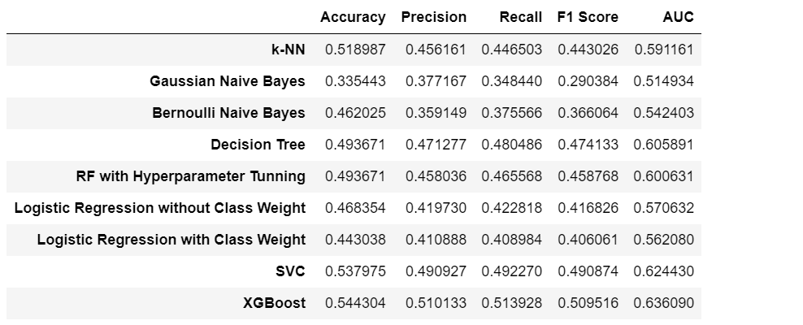
Summary of all Models

Slide 20
Thank you

